Slide 1
EnginAir
Connected Engine Data System Administrative Portal
Chloe Bates, Megan Mikami, Gennaro Napolitano, Ian Otto, Dylan Schreiner

Slide 2
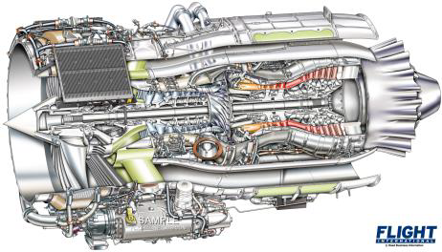
Background Info
1903 - Wright Brothers
Planes are the most used transportation
Gas turbines - Auxiliary Power Units (APUs)
Diagnostic reports are important for maintenance upkeep
Figure 1: APU
Notes:
In 1903, the Wright Brothers made history by building and flying the first successful powered airplane. This event propelled us into the aerial age and since then, airplanes have become the most commonly used mode of transportation, in the US, for long distances. Aviation and propulsion systems have greatly improved resulting in the aircrafts we have today. Many propulsion engines are available, but gas turbines, specifically, auxiliary power units are superior since they provide energy for aircraft functions other than just propulsion. These engines require periodic maintenance and are reported to the mechanics and engineers via a diagnostic report. Proper upkeep is important to prevent maintenance delays and keeps the engine functioning properly to ensure a safe flight. Our project, sponsored by Honeywell, aims to make this diagnostic report process more efficient by ensuring WiFi access points for operators to upload their reports to a cloud database.

Slide 3


Client & Company
Honeywell - Aerospace
Harlan Mitchell, Systems Technical Manager
HTF7K Controls System Integration Unit
Engine Control Unit (ECU)
Big team projects vs Small team projects
Waterfall over Agile
Federal Aviation Administration (FAA) regulations
Notes:
Harlan Mitchell is a systems technical manager whose team works on Engine Control Unit
Honeywell is the largest producer of gas turbine APUs with over 100,000 APUs produced and 36,000 still in use today.
Honeywell works heavily with aviation, because of this, FAA regulations are followed for code and their workflows are strictly enforced to prevent their engineers from “cutting corners”

Slide 4
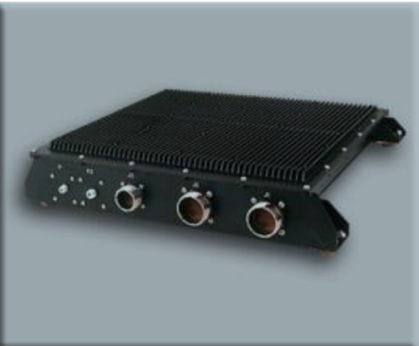
Problem
Manually download data and send via email
Connected Engine Data Access System (CEDAS)
Engine diagnostic reports connect using wifi
WiFi Connection Issues
Difficult to determine aircraft or engine status
Figure 2: CEDAS
Notes:
Currently Honeywell engine operators are required to download and send engine diagnostic data reports once a month. This process requires a manual port connection using a USB device and a cable, transferring file to USB drive, and sending the file via email. Not only is this process burdensome and tedious, it also results in a small data set of basic maintenance information.
Honeywell has developed a connected engine product called CEDAS which allows engines to autonomously upload engine data wirelessly to a cloud. This product is hosted on a embedded computer location in the aircraft along with a WiFi antenna. The problem with this is that, if the WiFi connection is spotty or is nonexistent at a certain location, the diagnostics may not send. When this happens, it is difficult to determine the status of the aircraft; whether it is grounded, inflight, or if there is a potential problem with the engine.

Slide 5

Planned Solution
Landing Status Monitor
Landing locations
Upload locations
WiFi Configuration
Latitude and Longitude mapping with precision
WiFi connectivity status and comparison to previous connections
Customer Connection Information Module
Web based interface
Google Maps Integration for Flight Patterns & plane tracking
Notes:
There are 3 Main Components of the project
Landing Monitor
- Collects Lat and Long for engine on/off and landing locations
- Integrates with WiFi Config Manager
WiFi Configuration Manager
- Physical Module on the plane that sends data to the cloud
This data is then used in the
Customer Connection Module(Sophisticated Web Portal)
- Google Maps integration
- Plots flight paths and landing data for airplanes
- If we see abnormalities in the data we then send
- User notifications about potential problems that might be happening
Our team was tasked with creating a Landing Status Monitor (LSM), a WiFi Configuration Manager, and a Customer Connection Information Module. The purpose of the LSM is the determine when and where the airplane landed. The idea is to mine data from public flight databases to estimate when a flight landed. If there is no report uploaded within 24 hours of this landing time, the user get notified with a corresponding message explaining what could be wrong. The purpose of the WiFi Configuration Manager is to be able to map specific longitude and latitude points on a map corresponding to a specific aircraft upload point. The Customer Connection Information Module is a web based interface that renders the information from part 2 into a graphical image that allows operators to be able to see where WiFi access points are locations and also shows the strength of the WiFi signals.

Slide 6
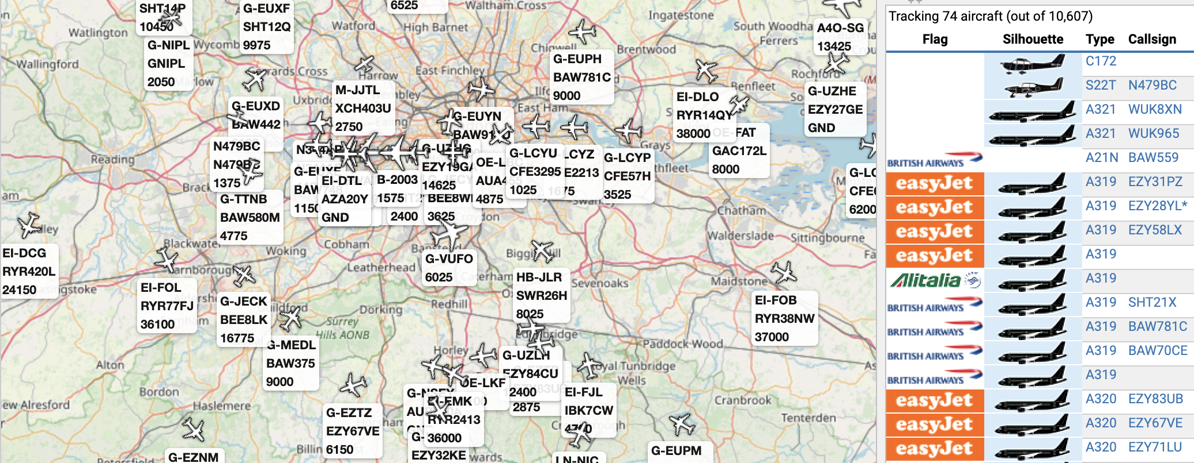
Plan for Development
Technical Investigation:
Web App (3)
Command Line Ingest (1)
ADS-B Exchange (2)
Requirements Acquisition:
Bi-weekly client meetings
Come with questions about requirements
Weekly status updates
Figure 3: ADS-B Portal
Notes:
To implement our planned solution, we will be working with three primary technologies. First, we will develop a command-line application (most likely using Java?) to ingest the information from the CEDAS system, as well as from our flight tracker to correlate possible landing locations and determine if a CEDAS upload was (a) possible and (b) successful. We’ll also be ingesting some other information that we’ll use in an effort to allow for autoconfiguration of Wi-Fi for different operators.. For the flight tracker, we will be investigating several options, but we’re focusing on ADS-B Exchange, as it can provide us with more detailed flight paths and has a more complete dataset. Finally, we will use a web-application (likely written in Python/Flask/Django?) that will serve as our frontend of the data we ingested through our command line application. Our goal is to make it simple for pilots to determine where they should park or stage their planes in order to ensure a complete upload.
To ensure that our requirements are in accordance to our client’s expectations, we decided that we will have bi-weekly conference meetings with our client. We will also send him our weekly task reports so that he is able to follow along with our project progression and provide feedback if necessary. We will also contact our client via email for more urgent questions/concerns that must be answered quickly.

Slide 7
Conclusion
Web based Landing Monitor & WiFi Configuration
Data uploads more frequently than previous methods
Selling point → Graphical interface of wifi connections
Notes:
In summary, we are Team EnginAir, and we are working to create a sophisticated web-based landing monitor and wifi configuration portal
This system will allow our client to efficiently diagnose why an engine diagnostic system may not be reporting. It will also allow them to recommend parking areas for the best upload quality
Honeywell needs their engines to stand out, our software and APIs are likely to do just that.

